Slide 1
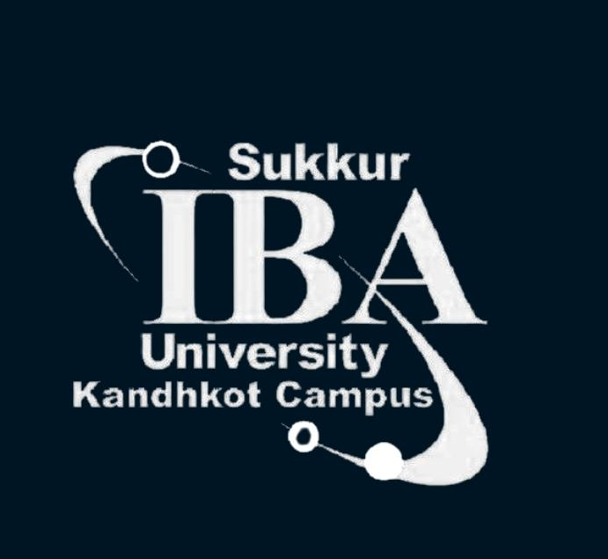

DATA SCIENCE ESSENTIALS
FOR BEGINNERS

Slide 2
DATA SCIENCE ESSENTIALS FOR BEGINNERS
Customer Churn Prediction
Credit Risk Modeling
Digital Lending
Customer Segmentation
Customer lifetime value (CLV)
Fraud Detection
ATM Cash Optimization
Income Proxy
Deposit Attrition
Cross-Sell/Up-sell recommendations
Agent Network Analysis
Branch Capacity Planning
Inter-Bank cash flow Analysis
Sentiment Analysis on customer reviews
Data Science
Use cases in
Banking

Slide 3
DATA SCIENCE ESSENTIALS FOR BEGINNERS
Cross-sectional Data
Cross-sectional data or cross-section of a population is obtained by taking observations from multiple individuals at the same point in time. Gross domestic product of countries in a given year is another example of cross-sectional data.
Types of Data
Time series Data
A time series is made up of quantitative observations on one or more measurable characteristics of an individual entity and taken at multiple points in time. Time series data is typically characterized by several interesting internal structures such as trend, seasonality, stationarity, autocorrelation, and so on.
Panel Data
If we observe multiple entities over multiple points in time, we get a panel data also known as longitudinal data.
Notes:
https://subscription.packtpub.com/book/big-data-and-business-intelligence/9781788290227/1/ch01lvl1sec8/different-types-of-data

Slide 4
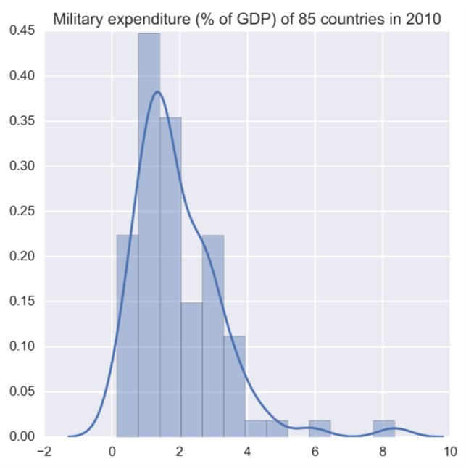
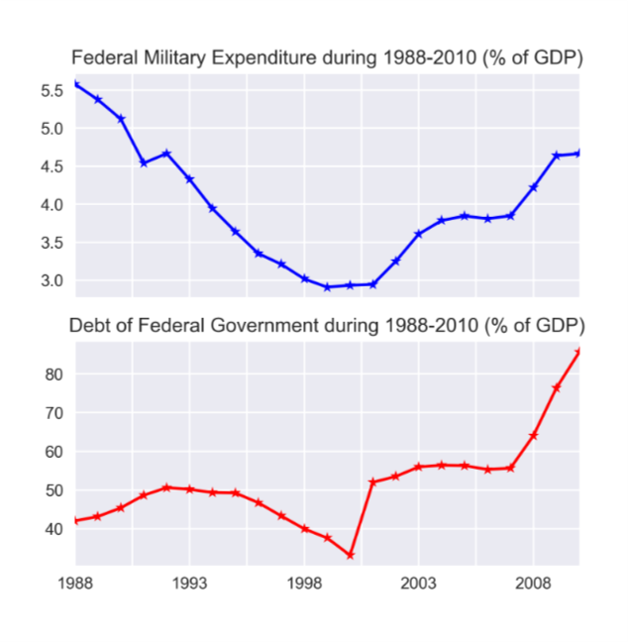
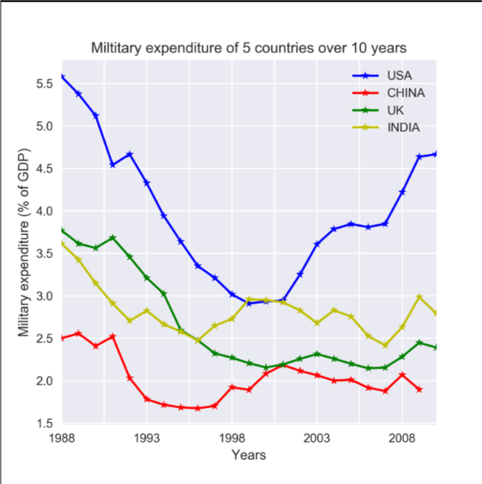
DATA SCIENCE ESSENTIALS FOR BEGINNERS

Slide 5
DATA SCIENCE ESSENTIALS FOR BEGINNERS
Cross-sectional Data
Time series Data
Panel Data

Slide 6
DATA SCIENCE ESSENTIALS FOR BEGINNERS
STATISTICS ESSENTIALS
Population: the source of data to be collected.
Sample: a portion of the population.
Variable: any data item that can be measured or counted.
Quantitative analysis (statistical): collecting and interpreting data with patterns and data visualization.
Qualitative analysis (non-statistical): producing generic information from other non-data forms of media.
Descriptive statistics: characteristics of a population.
Inferential statistics: predictions for a population.
Central tendency (measures of the center): mean (average of all values), median (central value of a data set), and mode (the most recurrent value in a data set).
Measures of the spread:
Range: the distance between each value in a data set.
Variance: the distance between a variable and its expected value.
Standard deviation: the dispersion of a data set from the mean.
Notes:
https://subscription.packtpub.com/book/big-data-and-business-intelligence/9781788290227/1/ch01lvl1sec8/different-types-of-data

Slide 7
DATA SCIENCE ESSENTIALS FOR BEGINNERS
ML ESSENTIALS
Clustering
Classification
Regression
Types of ML tasks
Forecasting
Generation
Recommendation
Prescriptive Analytics
Representation
Optimization
Notes:
https://subscription.packtpub.com/book/big-data-and-business-intelligence/9781788290227/1/ch01lvl1sec8/different-types-of-data

Slide 8
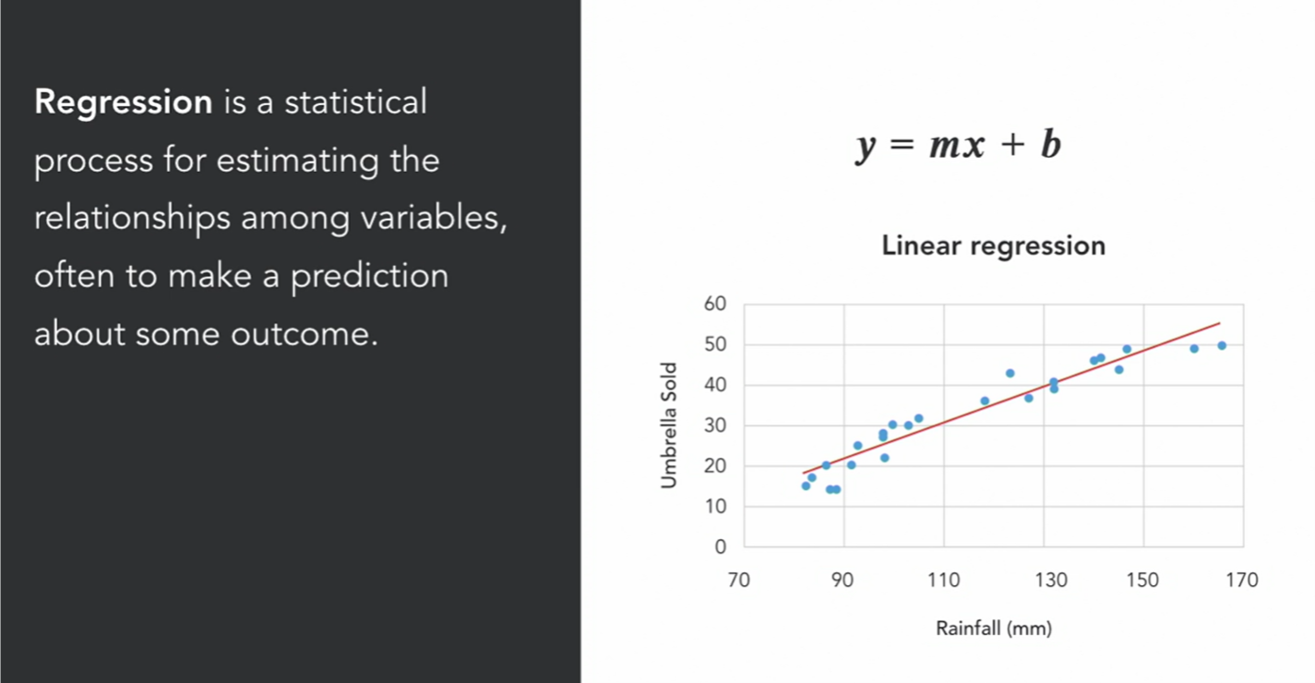
DATA SCIENCE ESSENTIALS FOR BEGINNERS
Notes:
https://subscription.packtpub.com/book/big-data-and-business-intelligence/9781788290227/1/ch01lvl1sec8/different-types-of-data

Slide 9
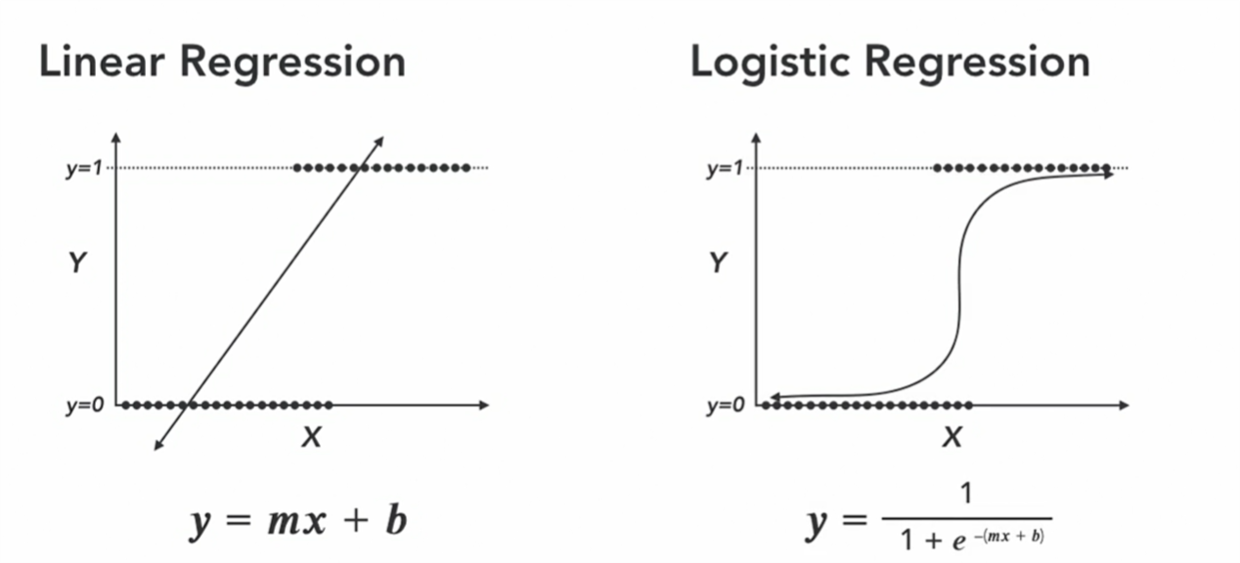
DATA SCIENCE ESSENTIALS FOR BEGINNERS
Logistic Regression is a form of Regression where the target variable is binary
Notes:
https://subscription.packtpub.com/book/big-data-and-business-intelligence/9781788290227/1/ch01lvl1sec8/different-types-of-data

Slide 10
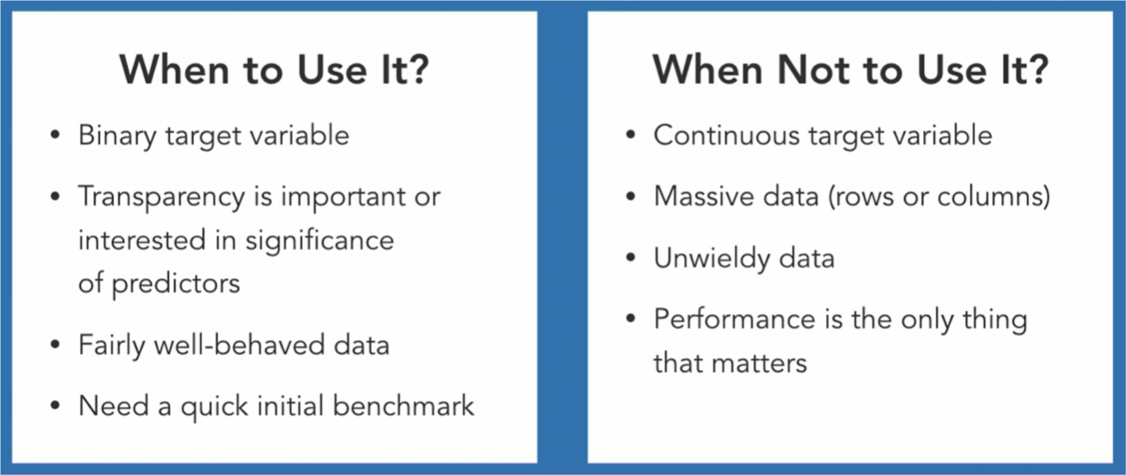
DATA SCIENCE ESSENTIALS FOR BEGINNERS
Notes:
https://subscription.packtpub.com/book/big-data-and-business-intelligence/9781788290227/1/ch01lvl1sec8/different-types-of-data

Slide 11
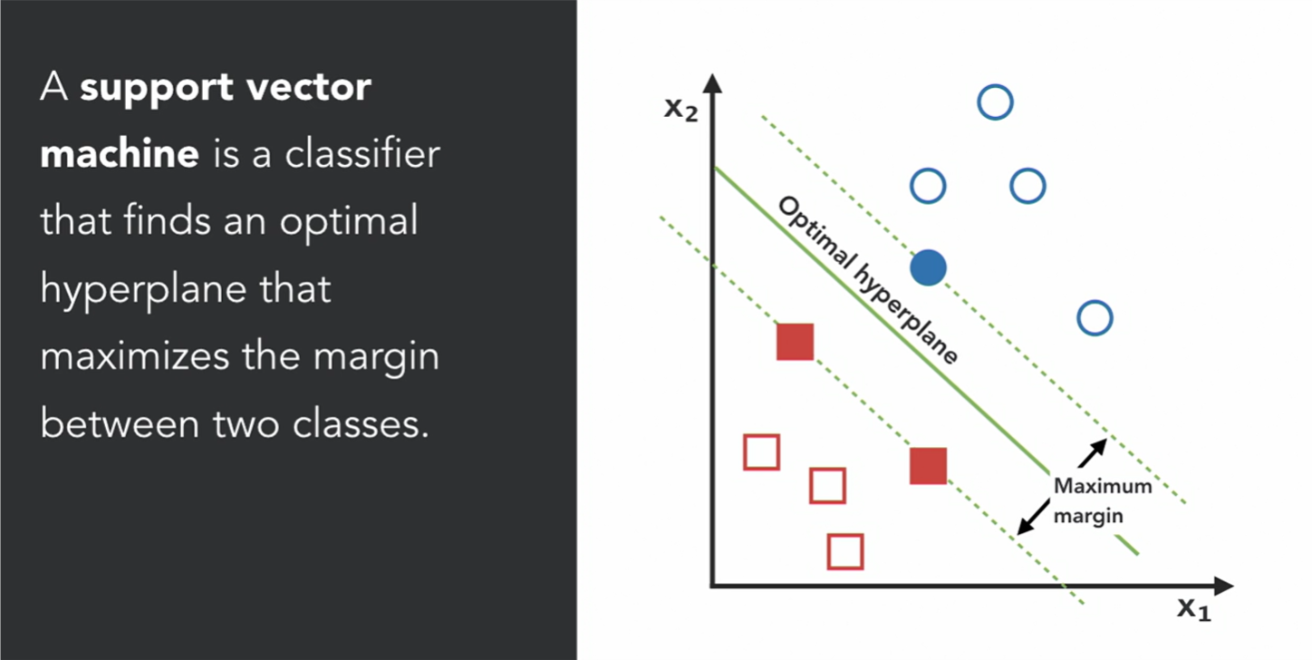
DATA SCIENCE ESSENTIALS FOR BEGINNERS
Notes:
https://subscription.packtpub.com/book/big-data-and-business-intelligence/9781788290227/1/ch01lvl1sec8/different-types-of-data

Slide 12
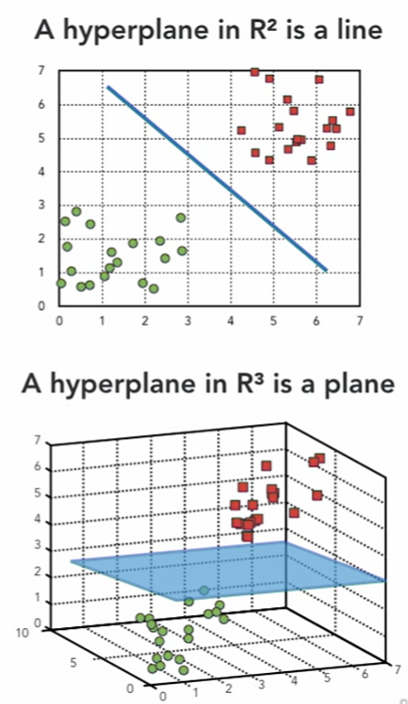
DATA SCIENCE ESSENTIALS FOR BEGINNERS
Notes:
https://subscription.packtpub.com/book/big-data-and-business-intelligence/9781788290227/1/ch01lvl1sec8/different-types-of-data

Slide 13
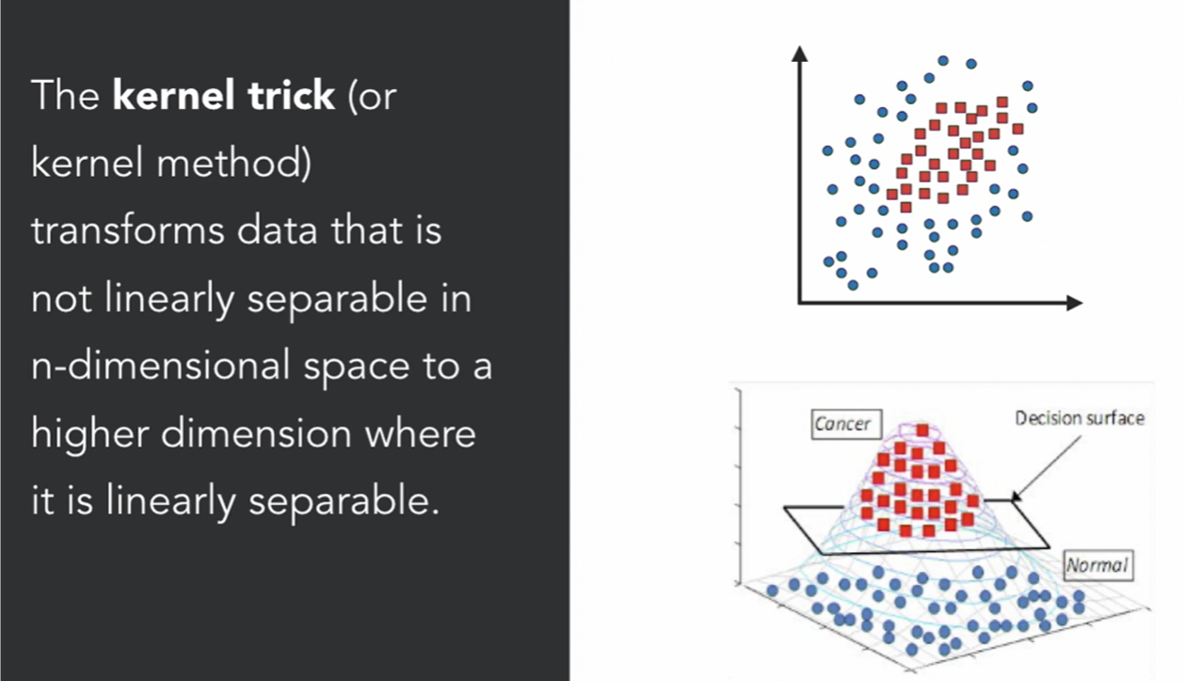
DATA SCIENCE ESSENTIALS FOR BEGINNERS
Notes:
https://subscription.packtpub.com/book/big-data-and-business-intelligence/9781788290227/1/ch01lvl1sec8/different-types-of-data

Slide 14
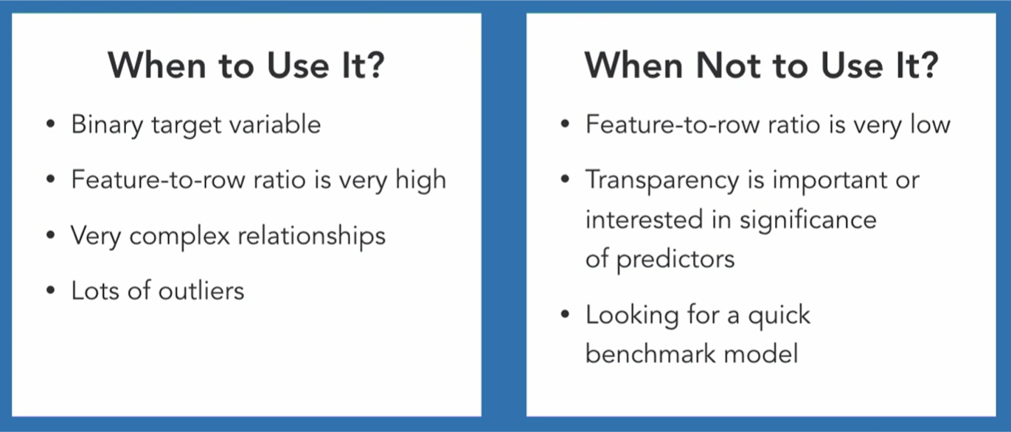
DATA SCIENCE ESSENTIALS FOR BEGINNERS
Notes:
https://subscription.packtpub.com/book/big-data-and-business-intelligence/9781788290227/1/ch01lvl1sec8/different-types-of-data

Slide 15
DATA SCIENCE ESSENTIALS FOR BEGINNERS
Pre-trained Models
HuggingFace
Model Zoo
PyTorch Hub
Tensorflow Hub
Serve Models
Flask, FastAPI
Dashboard/Visualize
Streamlit
Resources
Cloud Environments
Google Colab
Paperspace Gradient
Genesis Cloud
GitPod
AWS Sagemaker
Kaggle Kernel
Notes:
https://subscription.packtpub.com/book/big-data-and-business-intelligence/9781788290227/1/ch01lvl1sec8/different-types-of-data

Slide 16
DATA SCIENCE ESSENTIALS FOR BEGINNERS
How to follow an ML course
https://betterexplained.com/articles/adept-machine-learning-course/
ML Glossary
https://developers.google.com/machine-learning/glossary#z
Create Your Portfolio
https://chriskhanhtran.github.io/_posts/2020-01-13-portfolio-tutorial/
https://towardsdatascience.com/9-minutes-to-a-data-science-portfolio-website-80b79ced6c54
Resources
Notes:
https://subscription.packtpub.com/book/big-data-and-business-intelligence/9781788290227/1/ch01lvl1sec8/different-types-of-data

Slide 17
DATA SCIENCE ESSENTIALS FOR BEGINNERS
Udacity
Highly professional and well-structured content.
(AWS Machine Learning Foundations is a free course. Do try!)
Datacamp
Coding playground and to-the-point implementation-oriented courses. Short
courses and guided projects. Start “Data Scientist” career track.
Coursera
Some specializations are well-reputed. They require persistence and pay back!
Machine Learning Specialization
Deep Learning Specialization
Python for Everybody Specialization
LinkedIn Learning
Highly professional wisely picked content. Good for quickly grasping technical content easily with tons of examples and projects.
Udemy
Too many courses with huge amount of content. Good for increasing breath of knowledge rather than depth of concepts. Machine Learning A-Z™: Hands-On Python & R In Data Science
Comparison of Online Learning Platforms
Notes:
https://subscription.packtpub.com/book/big-data-and-business-intelligence/9781788290227/1/ch01lvl1sec8/different-types-of-data

Slide 18
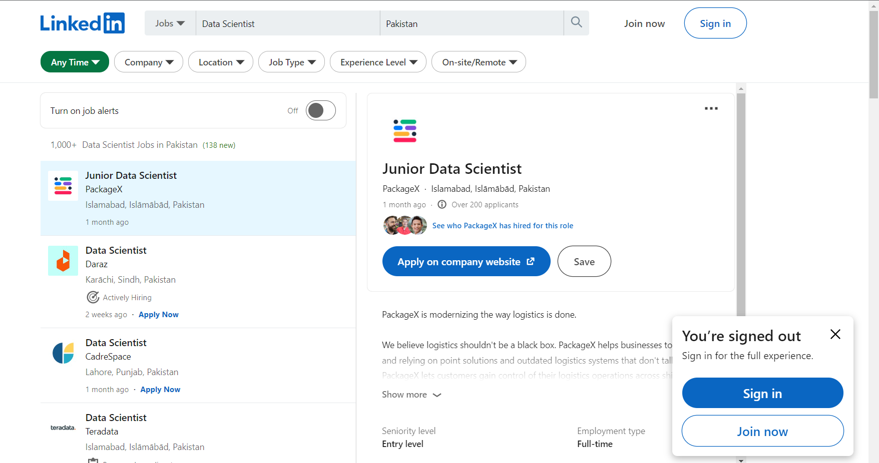
DATA SCIENCE ESSENTIALS FOR BEGINNERS
Jobs
Notes:
https://subscription.packtpub.com/book/big-data-and-business-intelligence/9781788290227/1/ch01lvl1sec8/different-types-of-data

